Slide 1


Aswini Dileep
08/12/2025

Slide 2

Outline
Executive Summary
Introduction
Methodology
Results
Conclusion
Appendix

Slide 3
Executive Summary
Summary of methodologies
This project follows these steps:
Data Collection
Data Wrangling
Exploratory Data Analysis
Interactive Visual Analysis
Predictive Analysis (Classification)
Summary of all results
This project produced the following outputs and visualizations:
EDA results
Interactive dashboard
Predictive analysis of classification models

Slide 4
Introduction
Project background and context:
SpaceX launches Falcon 9 rockets at a cost of around $62m. This is considerably cheaper than other providers (which usually cost upwards of $165m), and much of the savings are because SpaceX can land, and then re-use the first stage of the rocket.
Problems you want to find answers:
What factors influence the successful landing of the Falcon 9 first stage?
How can we accurately predict the landing outcome using machine learning models?
Which machine learning model performs best in predicting the landing success?

Slide 5

Section 1

Slide 6
Methodology
Data collection methodology:
Require the data from SpaceX API
Collect data from a Wikipedia page
Perform data wrangling
Perform EDA to find some patterns
Determine what would be the label for training supervised model
Perform exploratory data analysis (EDA) using visualization and SQL
Perform interactive visual analytics using Folium and Plotly Dash
Perform predictive analysis using classification models
Compare logistic regression model, SVM, decision tree classifier, kNN by using GridSearchCV to select the best fit model

Slide 7
Data Collection
Step 1: SpaceX API Request
Initiate API Request
Fetch Launch Data
Store Data Locally
Step 2: Web Scraping Wikipedia
Extract HTML Table
Parse with BeautifulSoup
Convert to DataFrame
Step 3 : Data Integration
SpaceX API data and Wikipedia data
Merge Datasets
Final Integrated Data

Slide 8
Data Collection – SpaceX API
Request data
Convert into DataFrame
Data Wrangling
Save to .csv file
GitHub URL
https://github.com/Aswini-Dileep/SpaceX-Falcon-9-first-stage-Landing-Prediction/blob/main/jupyter-labs-spacex-data-collection-api.ipynb

Slide 9
Data Collection - Scraping
GitHub URL
https://github.com/Aswini-Dileep/SpaceX-Falcon-9-first-stage-Landing-Prediction/blob/main/jupyter-labs-webscraping.ipynb
Request data
Extract data
Parse data
Save to .csv file

Slide 10
Data Wrangling
Data Cleaning
Data Transformation
Data Integration
Data Validation
GitHub URL
https://github.com/Aswini-Dileep/SpaceX-Falcon-9-first-stage-Landing-Prediction/blob/main/labs-jupyter-spacex-Data%20wrangling.ipynb

Slide 11
EDA with Data Visualization
Scatter plot - Best to describe the relation between two categorical data.
The relationship between Flight number and Launch Site.
The relationship between Payload and Launch Site.
The relationship between Payload and Orbit type.
The relationship between Payload and Orbit type.
Bar Plot – Best to compare several categorical data
The relationship between Success rate of each Orbit type
Line Chart – Best to show the time series data
The launch success yearly trend
GitHub URL
https://github.com/Aswini-Dileep/SpaceX-Falcon-9-first-stage-Landing-Prediction/blob/main/edadataviz.ipynb

Slide 12
EDA with SQL
Display the names of the unique launch sites in the space mission
Display 5 records where launch sites begin with the string 'CCA'
Display the total payload mass carried by boosters launched by NASA (CRS)
Display average payload mass carried by booster version F9 v1.1
List the date when the first successful landing outcome in ground pad was achieved.
List the names of the boosters which have success in drone ship and have payload mass greater than 4000 but less than 6000
List the total number of successful and failure mission outcomes
List all the booster_versions that have carried the maximum payload mass, using a subquery with a suitable aggregate function.
List the records which will display the month names, failure landing_outcomes in drone ship ,booster versions, launch_site for the months in year 2015.
Rank the count of landing outcomes (such as Failure (drone ship) or Success (ground pad)) between the date 2010-06-04 and 2017-03-20, in descending order.
https://github.com/Aswini-Dileep/SpaceX-Falcon-9-first-stage-Landing-Prediction/blob/main/jupyter-labs-eda-sql-coursera_sqllite.ipynb

Slide 13
Build an Interactive Map with Folium
Mark all launch sites on the map
Mark the success/failed launches for each site on map
Calculate the distance between a launch site to its proximities
To find some geographical patterns about launch sites
GitHub URL
https://github.com/Aswini-Dileep/SpaceX-Falcon-9-first-stage-Landing-Prediction/blob/main/lab_jupyter_launch_site_location.ipynb

Slide 14
Build a Dashboard with Plotly Dash
A launch site dropdown input component
A success pie-chart based on the selected site dropdown
A range slicer to select payload
A success payload scatter chart scatter plot based on the selected site dropdown
To inspect the relationship of success rate between launch site and payload

Slide 15
Predictive Analysis (Classification)
Data Wrangling
Data Standardization
Split into training and test datasets
Predictive Model Evaluation
Predictive Model Selection
Logistic Regression Model
Support Vector Machine Model
Decision Tree Classifier
k-Nearest Neighbor Model
GitHub URL
https://github.com/Aswini-Dileep/SpaceX-Falcon-9-first-stage-Landing-Prediction/blob/main/7.%20SpaceX_Machine_Learning_Prediction_Part_5.jupyterlite.ipynb

Slide 16
Results
Exploratory Data Analysis
Interactive Analytics
Predictive Analysis

Slide 17

Section 2

Slide 18
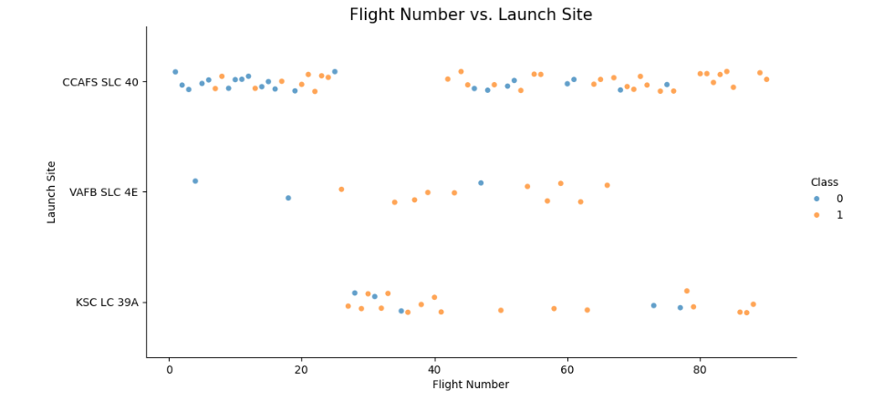
Flight Number vs. Launch Site
KSC LC 39A has the highest success rate and CCAFS SLC 40 has the lowest.

Slide 19
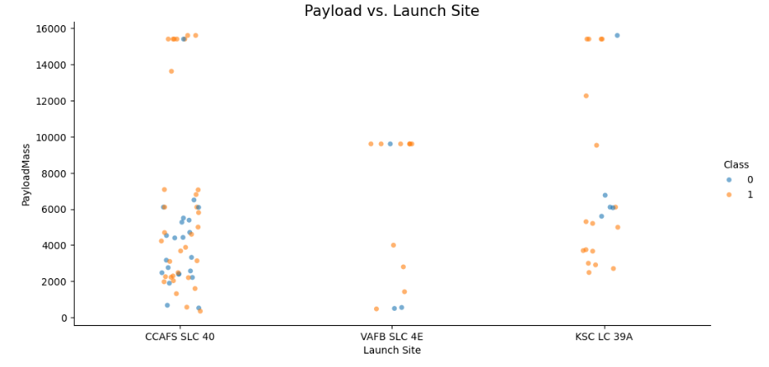
Payload vs. Launch Site
VAFB SLC 4E has no payload above 10000 kg

Slide 20
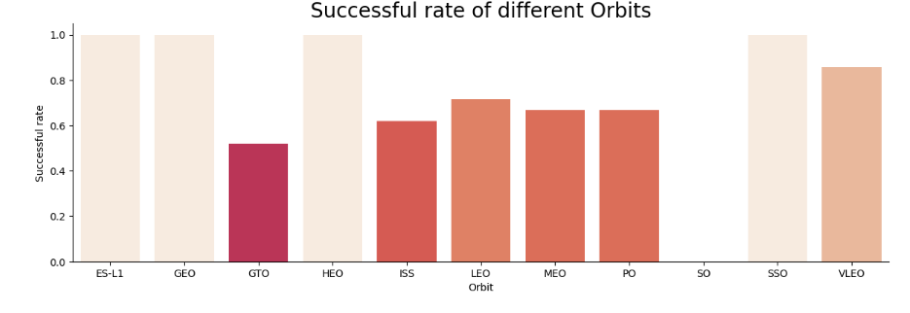
Success Rate vs. Orbit Type
ES-L1, GEO, HEO and SSO have the highest success rates

Slide 21
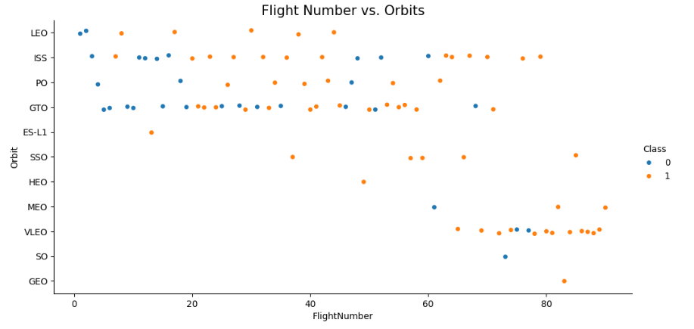
Flight Number vs. Orbit Type
In the LEO orbit the Success appears related to the number of flights. On the other hand, there seems to be no relationship between flight number when in GTO orbit.

Slide 22
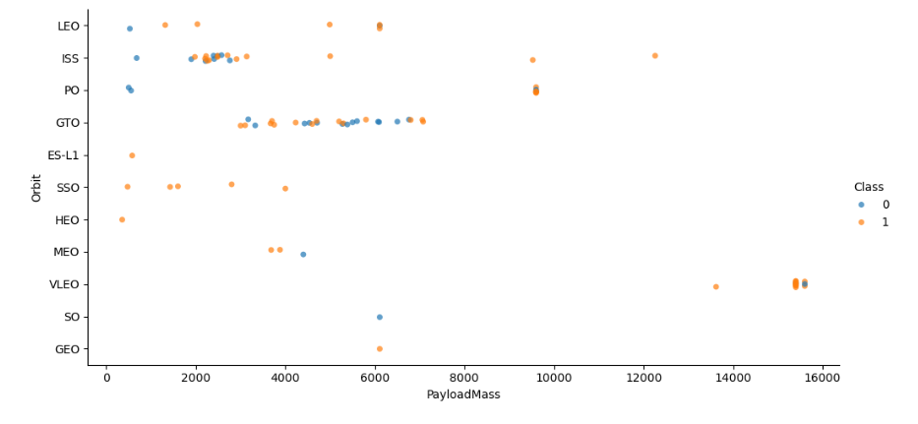
Payload vs. Orbit Type
With heavy payloads the successful landing or Positive landing rate are more for Polar, LEO and ISS. However for GTO we cannot distinguish this well as both positive landing rate and negative landing (Unsuccessful mission) are both there here.

Slide 23
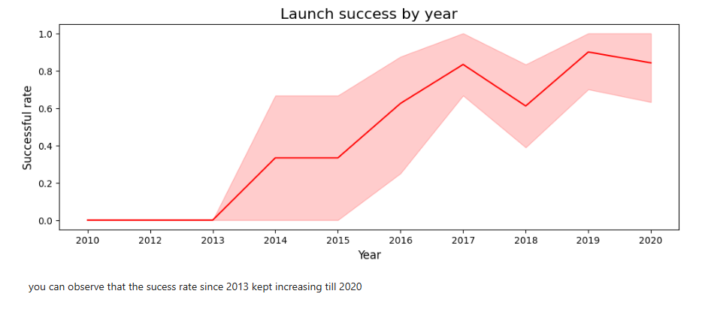
Launch Success Yearly Trend

Slide 24
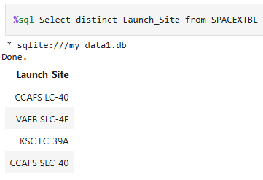
All Launch Site Names

Slide 25
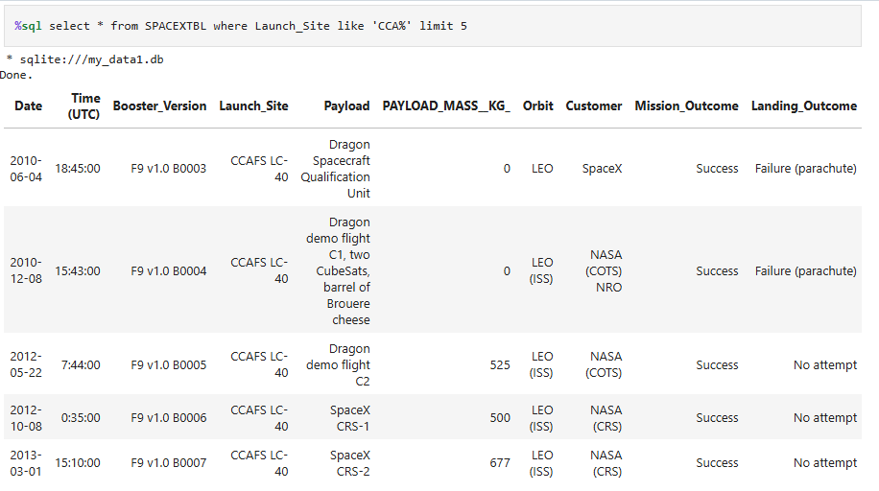
Launch Site Names Begin with 'CCA'

Slide 26
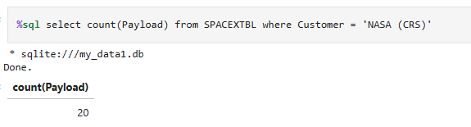
Total Payload Mass

Slide 27
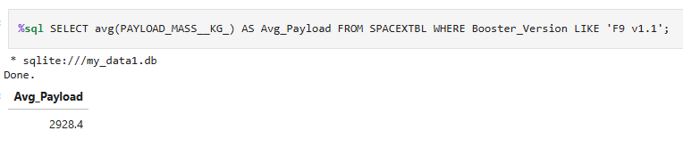
Average Payload Mass by F9 v1.1

Slide 28
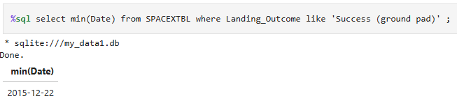
First Successful Ground Landing Date

Slide 29
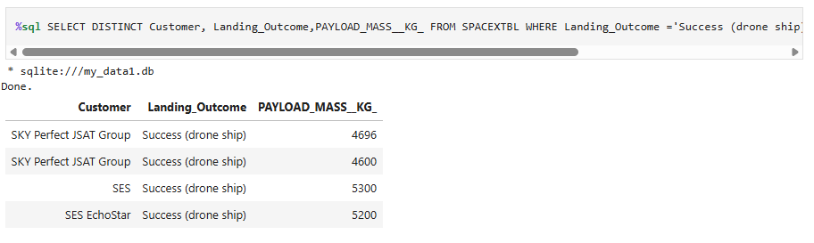
Successful Drone Ship Landing with Payload between 4000 and 6000

Slide 30
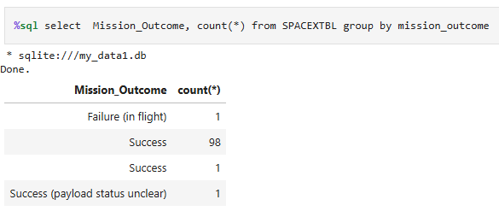
Total Number of Successful and Failure Mission Outcomes

Slide 31
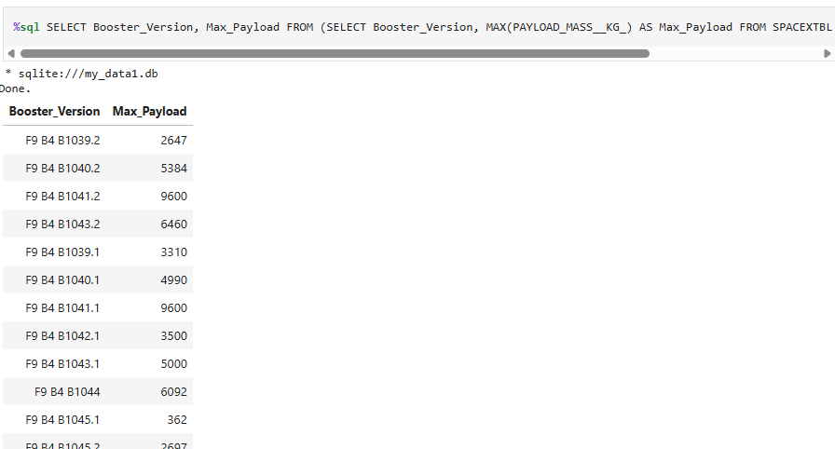
Boosters Carried Maximum Payload

Slide 32
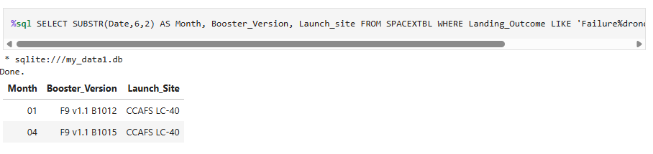
2015 Launch Records

Slide 33
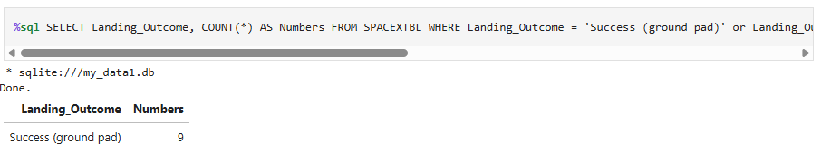
Rank Landing Outcomes Between 2010-06-04 and 2017-03-20

Slide 34

Section 3

Slide 35
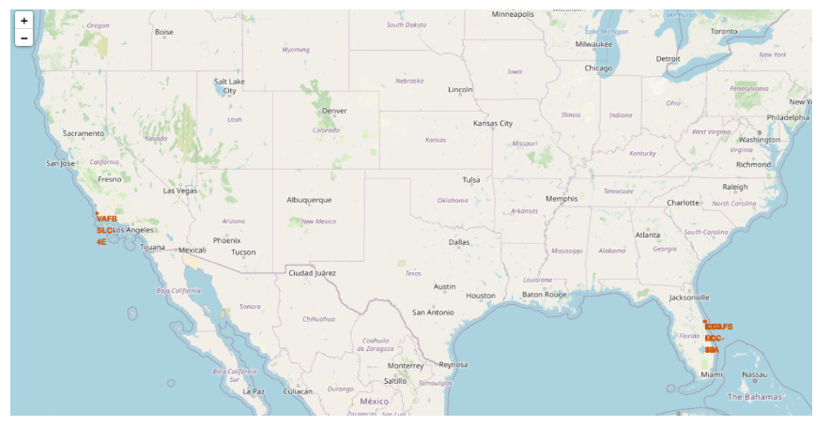
All Launch Sites

Slide 36
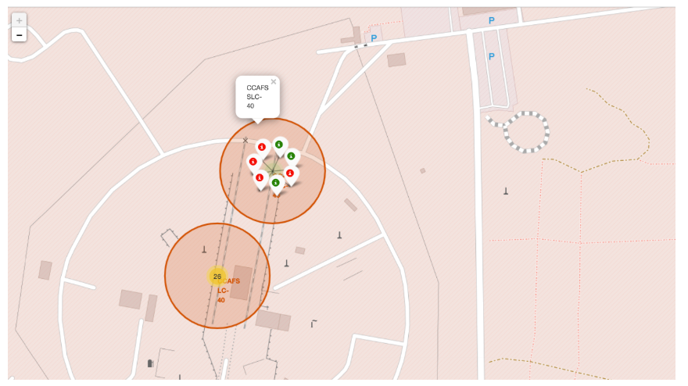
Success/Failed Launches For Each Site On The Map

Slide 37
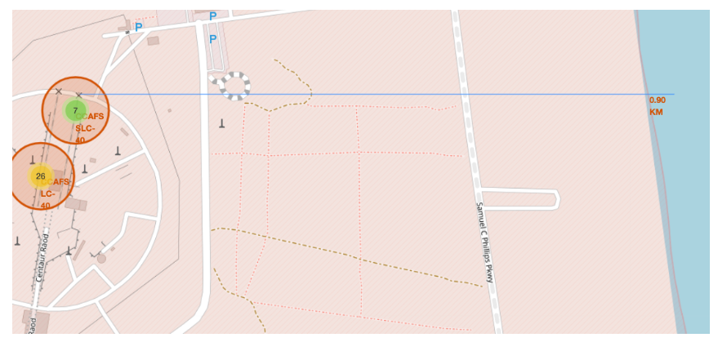
Distances Between a Launch Site to its Proximities

Slide 38

Section 4

Slide 39
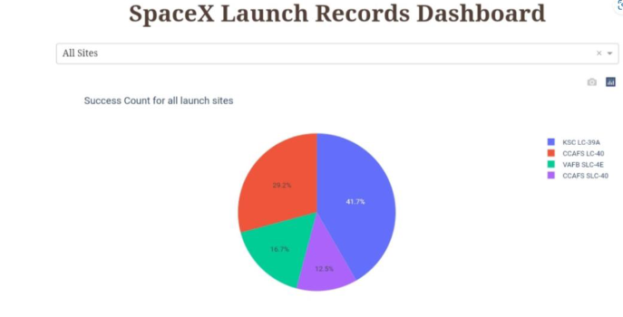
All Launch Sites

Slide 40
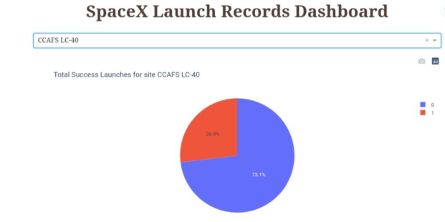
Highest Success Launch Ratio

Slide 41
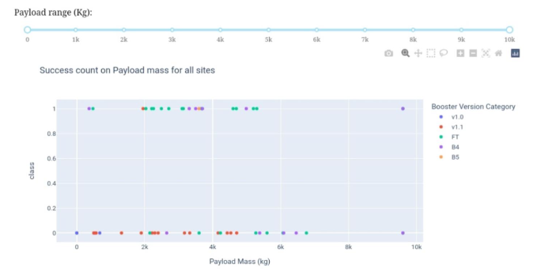
Payload Vs Launch Outcome

Slide 42

Section 5

Slide 43
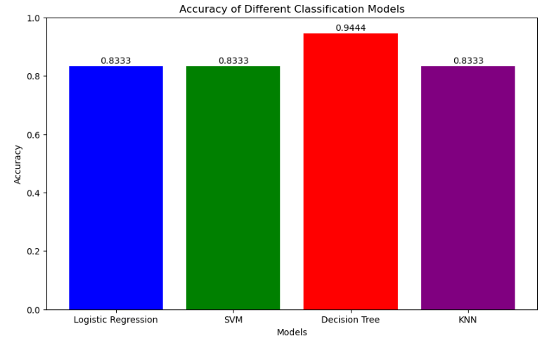
Classification Accuracy

Slide 44
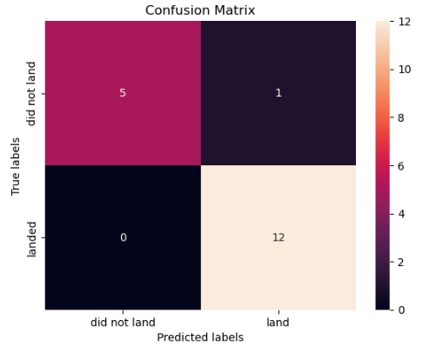
Confusion Matrix

Slide 45
Conclusions
There is a correlation between launch site and success rate Payload mass, which is also associated with the success rate. The more massive the payload the less likely the first stage will return.
For orbit, SO has the least success rate while ES-L1, GEO, HEO, and SSO have the highest success rate according to the yearly trend.
There has been an increase in the success rate since 2013 kept increasing till 2020
With best parameter provided, decision tree classifier used in prediction yielded the highest accuracy of 89%

Slide 46
Appendix
https://github.com/Aswini-Dileep/SpaceX-Falcon-9-first-stage-Landing-Prediction

Slide 47


